Slide 1
Stock Market Price Prediction
Swapnil Deshmukh

Slide 2
Introduction
Financial market are highly volatile and generate huge amount of data daily.
Stock prices are predict to determine the future value of campanies stock or other financial instuments that are marked on financial exchange.
However, stock market is influenced by many factors such as political events, economic conditions and traders exceptation.

Slide 3
Problem Statement
How to predict stock price?
Time Series forecasting and modeling plays important role in data analysis. Time series analysis is specialized branch of Operation research and Econometrics. Time series is used widely in analytics and Data Science.
Stock price are volatile in nature and price depends on various factors. Aim of project is predict stock prices using Long Short Term Model(LSTM).

Slide 4
Technology used:
Python
Sklearn Library
LSTM Model of neural network
Support vector machine
Neuro-Fuzzy systems

Slide 5
What is Machine learning?
Machine Learning is field to study that gives computer the ablity to learn without being explicitly programmed.
The computer program is said to learn from experience with respect to some class tesk and performance measure.

Slide 6
What is LSTM?
LSTM is ‘Long Short Term Memory’.
It is used in fields of AI and Deep Learning.
It is capable of learning sequence prediction problem.
It is applicable to handwriting recognition, speech recognition, etc.
It has input gate, output gate and forget gate these 3 cells.

Slide 7
How machine learning is used in price prediction?
Many Libraries are available in machine learning for making a model.
In this models we can train the data and by training that data we can predict the next time data in it.
Time -series prediction is common technique widely used in many real world applications such as weather forecasting and financial market prediction.
By using LSTM model we can predict the stock price.

Slide 8
Working
Loading previous year data
Loading previous year data
Train and test split the data and then data preprocessing
Train and test the data by spliting it
By using LSTM 3 gates, we can trai and test the data
Then predict model for next data

Slide 9
Input
Input
Dataset
Trained Data
Text Data
Pre-processing
Prediction Algorithm
Pre-processing
Trained Model
Prediction
Result

Slide 10
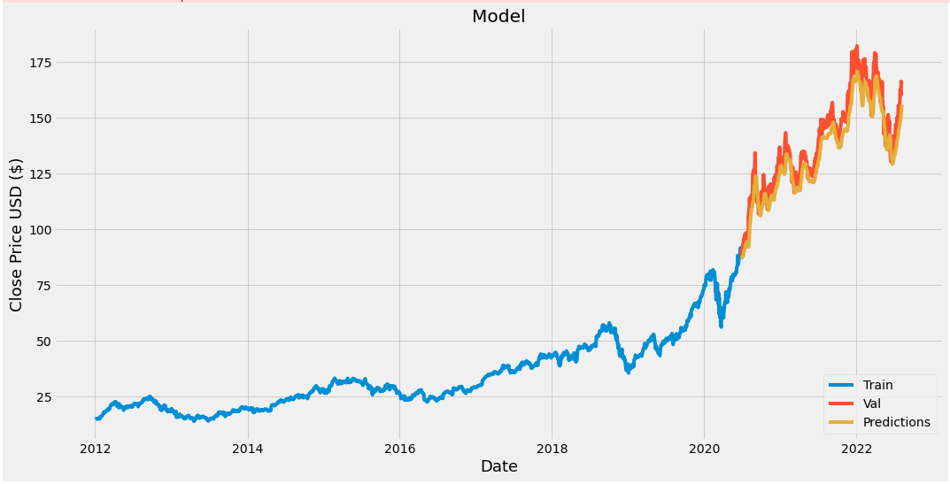
Predicting the price of by training previous dataset.

Slide 11

Source code

Slide 12
Benefits of application
This technique is effective for predicting future prices of stock
Effective prediction system indirectly help treders byproviding supportive information such as future market direction.
It is useful in research of stock market development
Financial analyst investors can use this prediction model to take treding decision by observing market behaviour.
Neuro-Fuzzy systems

Slide 13
Conclusion:
Determining the stock market forcast is always been challenging work for business analysts.
Thus project applies the Machine Learning technology of LSTM to predict the stock prices. Here it use previous years data. If training data is in large quantity then it will be more accurate to predict future price of stock.

Slide 14
Reference:
https://en.wikipedia.org/wiki/Long_short-term_memory
https://www.geeksforgeeks.org/long-short-term-memory-networks-explanation/
Azoff, E.M. Neural Network Time Series Forecasting of Financial Markets John Wiley and Sons Ltd, 1994.

Slide 15
Thank You...!

